Slide 1

Workshop
Atharva Pawar
Shaun Pimenta

Slide 2
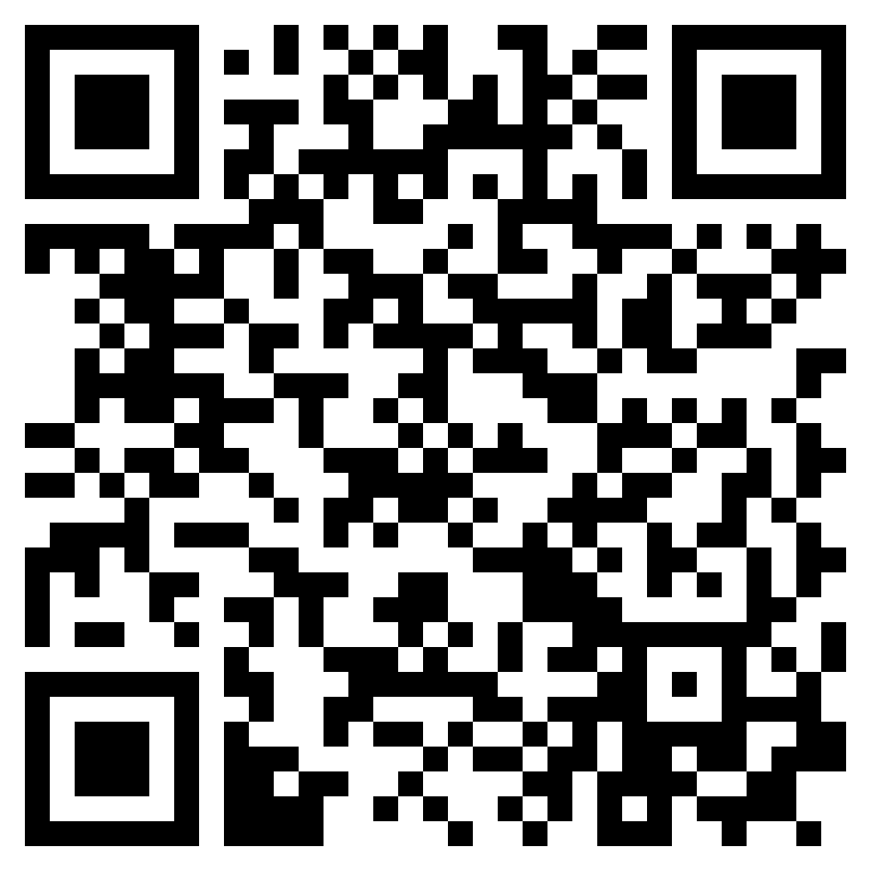
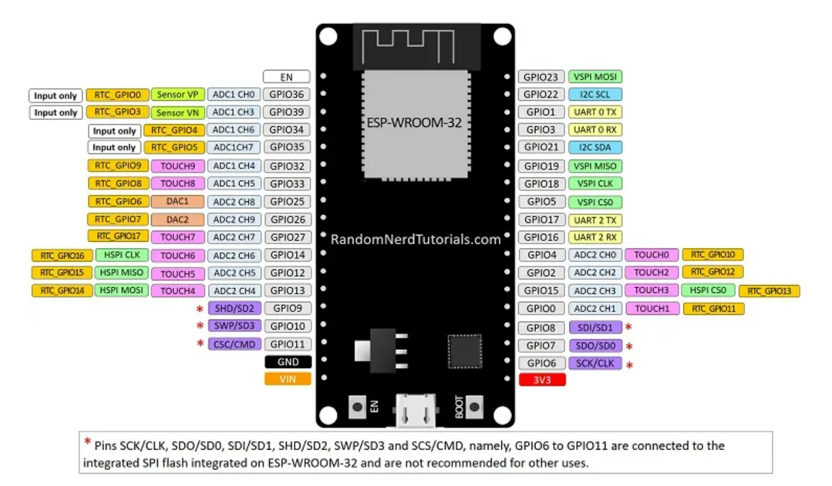
Index Basic Interfacing
Database Connection (Thingspeak)
Esp32 Pinouts
IoT Workshop

Slide 3
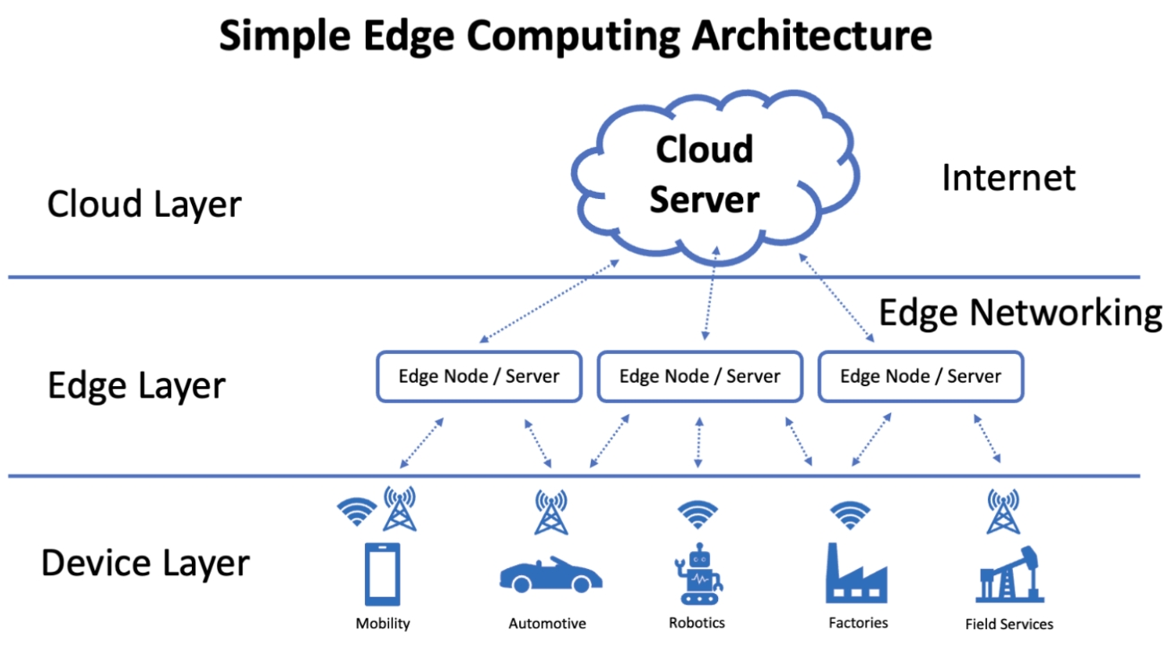
IoT Workshop

Slide 4



Tools
IoT Workshop

Slide 5
Interfacing:
Basic Electronics:
Led, Potentiometer, Slide Switch
Output Device:
I2C 16x2 LCD, Neo Pixel, PIR, Buzzer, Servo, Relay
Input Device:
DHT22
IoT Workshop

Slide 6
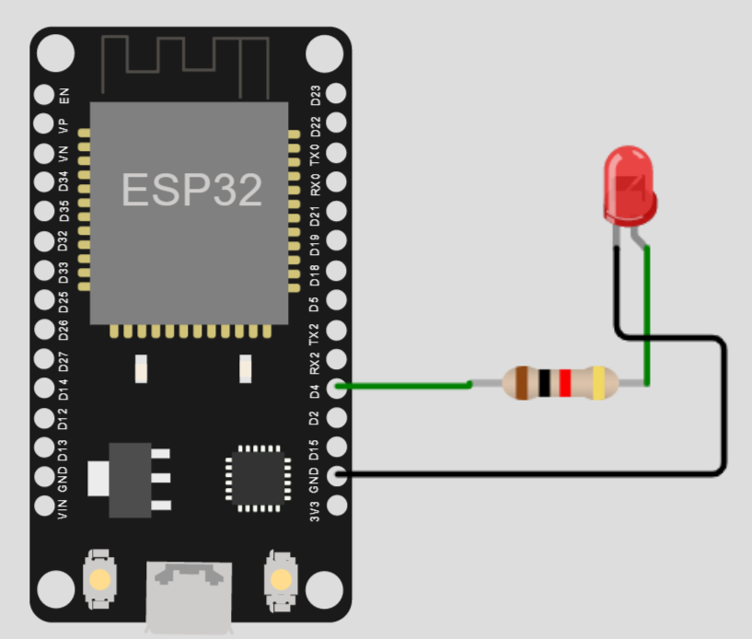
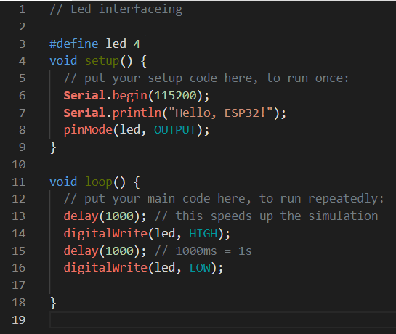
Basic Electronics: Led (Link)
IoT Workshop

Slide 7
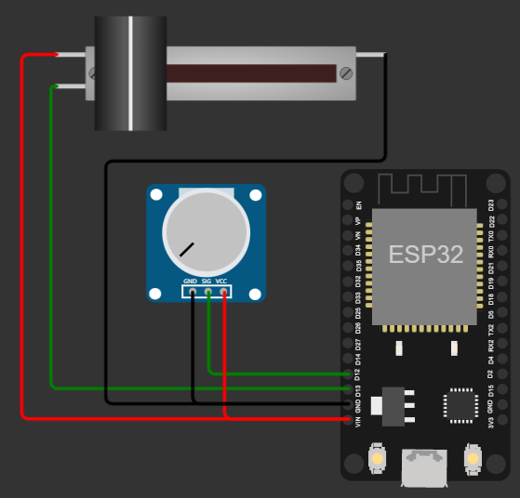
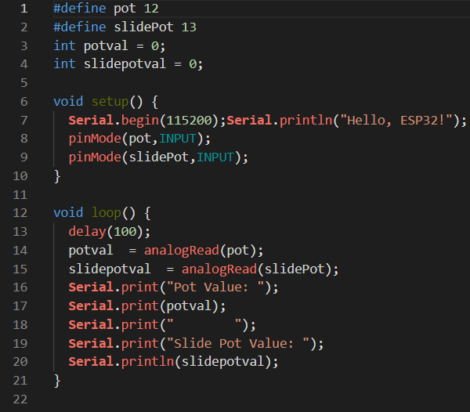
Basic Electronics: Potentiometer (Link)
IoT Workshop

Slide 8
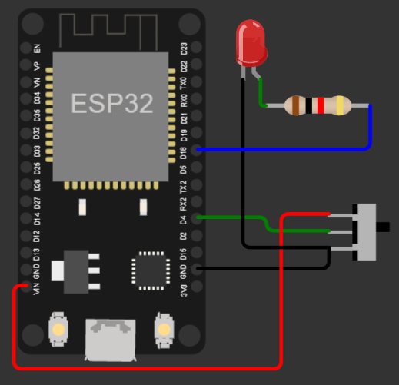
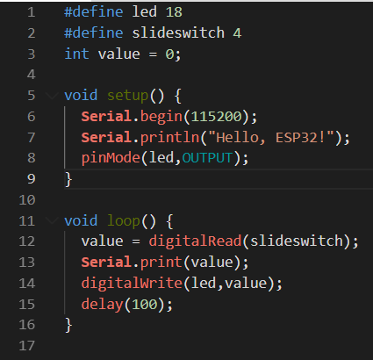
Basic Electronics: Slide Switch (LINK)
IoT Workshop

Slide 9
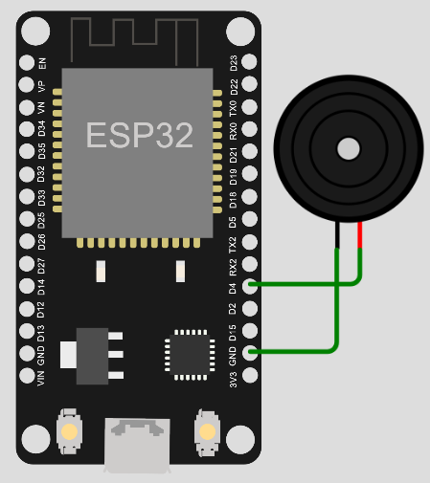
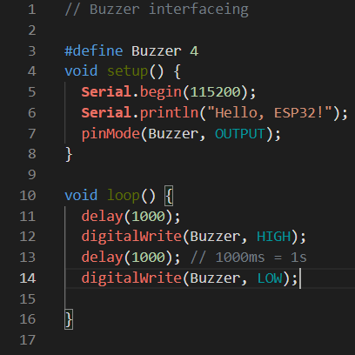
Output Device: Buzzer
IoT Workshop

Slide 10
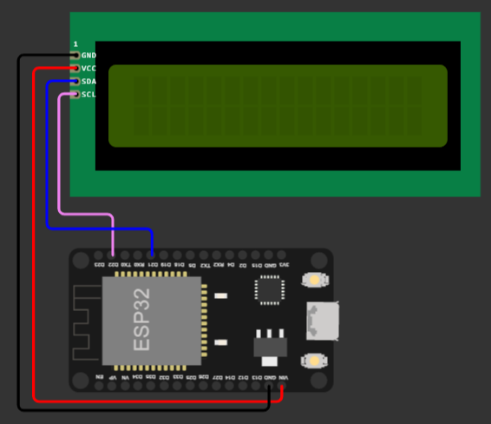
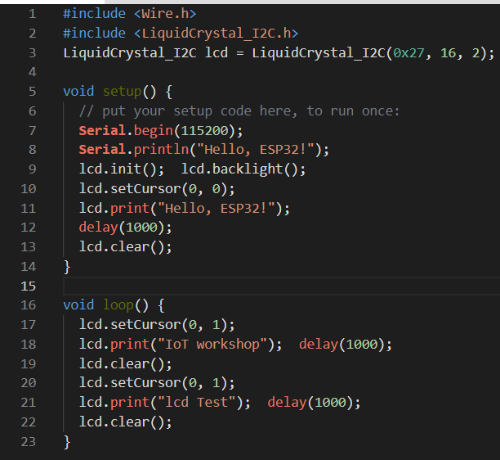
Output Device: I2C 16x2 LCD(Link)
IoT Workshop

Slide 11
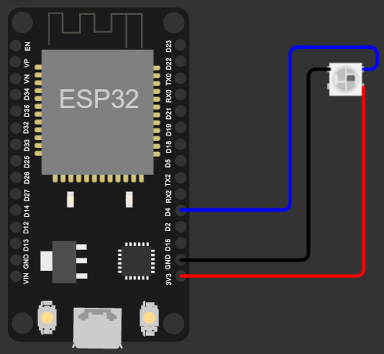
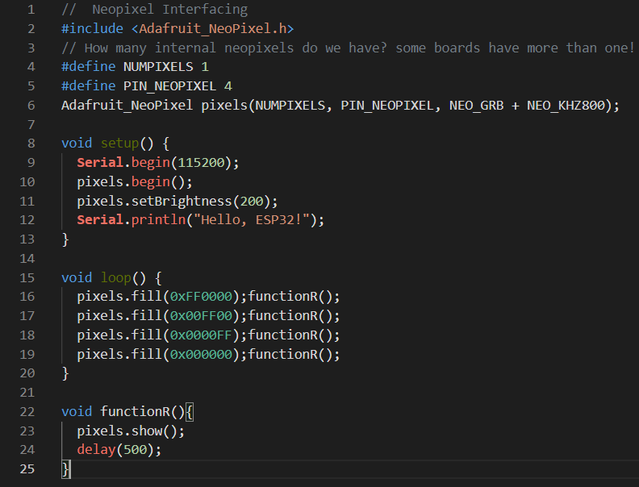
Output Device: Neo Pixel (Link)
IoT Workshop

Slide 12
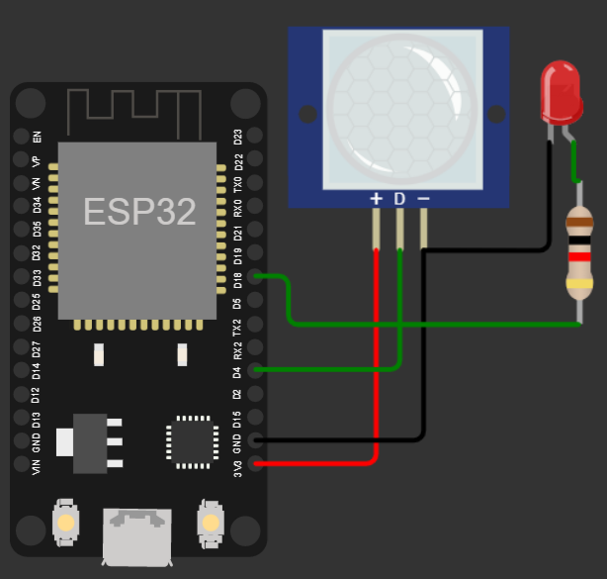
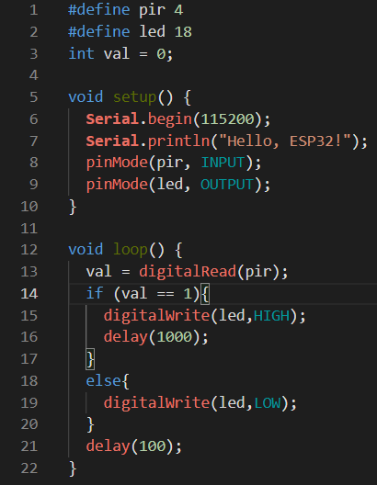
Input Device: PIR(link)
IoT Workshop

Slide 13
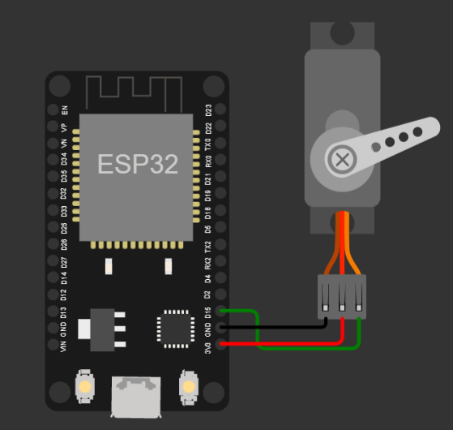
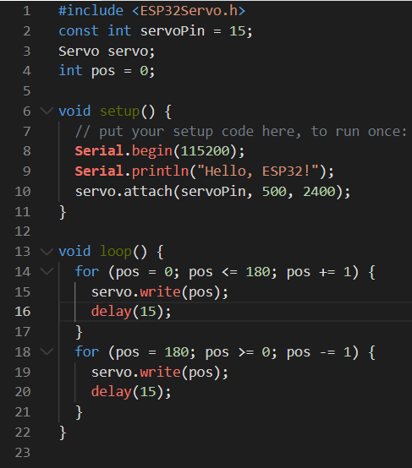
Output Device: Servo(LINK)
IoT Workshop

Slide 14
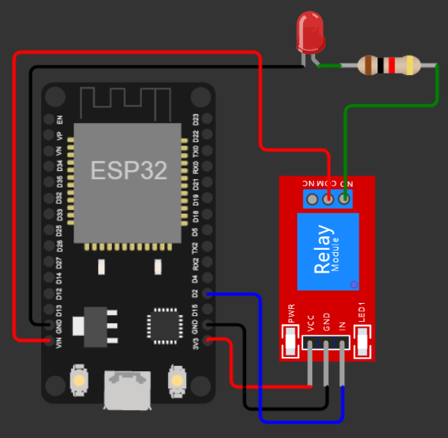
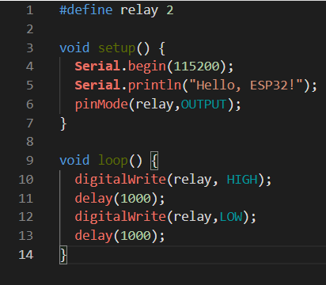
Output Device: Relay(link)
IoT Workshop

Slide 15
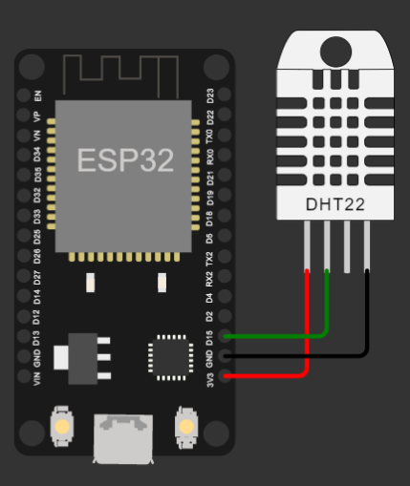
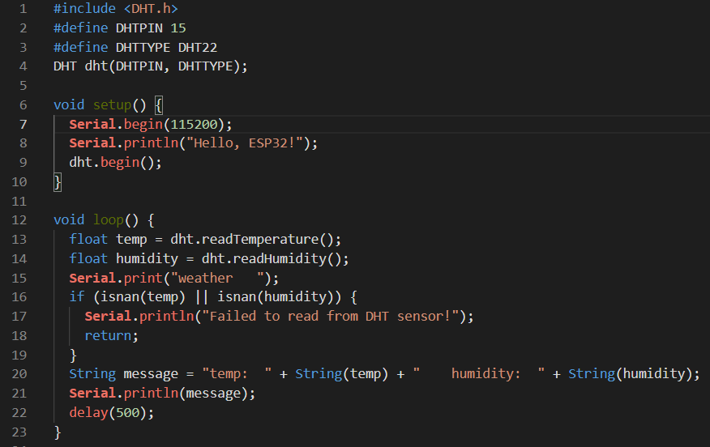
Input Device: DHT22(link)
IoT Workshop

Slide 16
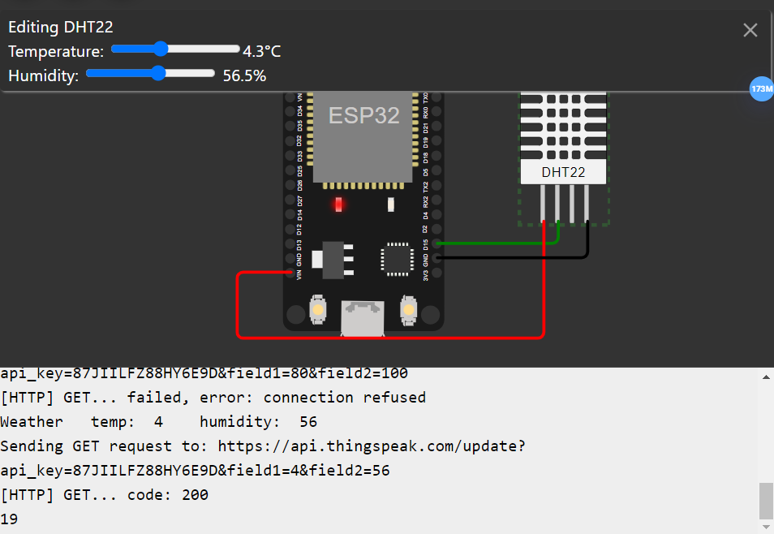
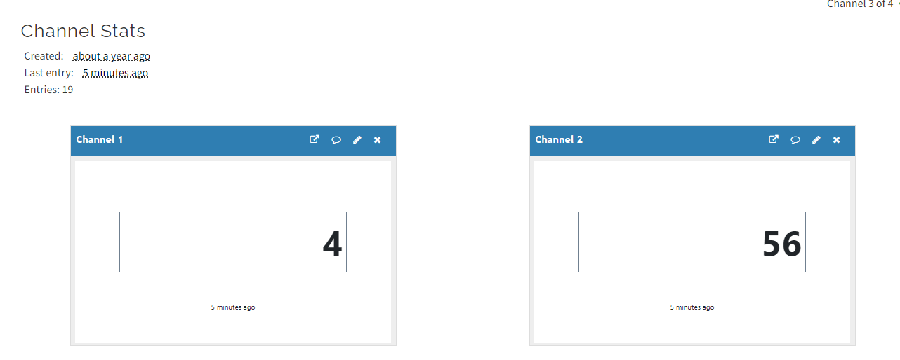
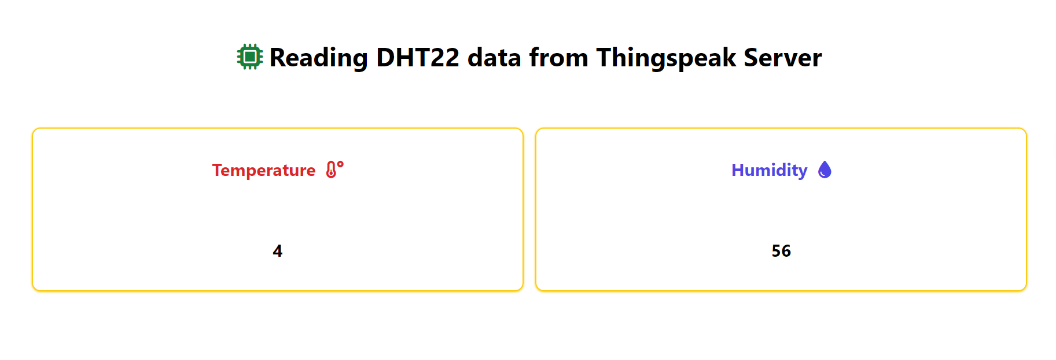
IoT (Read DHT22 & Upload the DHT22 Data): Thingspeak(dB)(link)
IoT Workshop

Slide 17
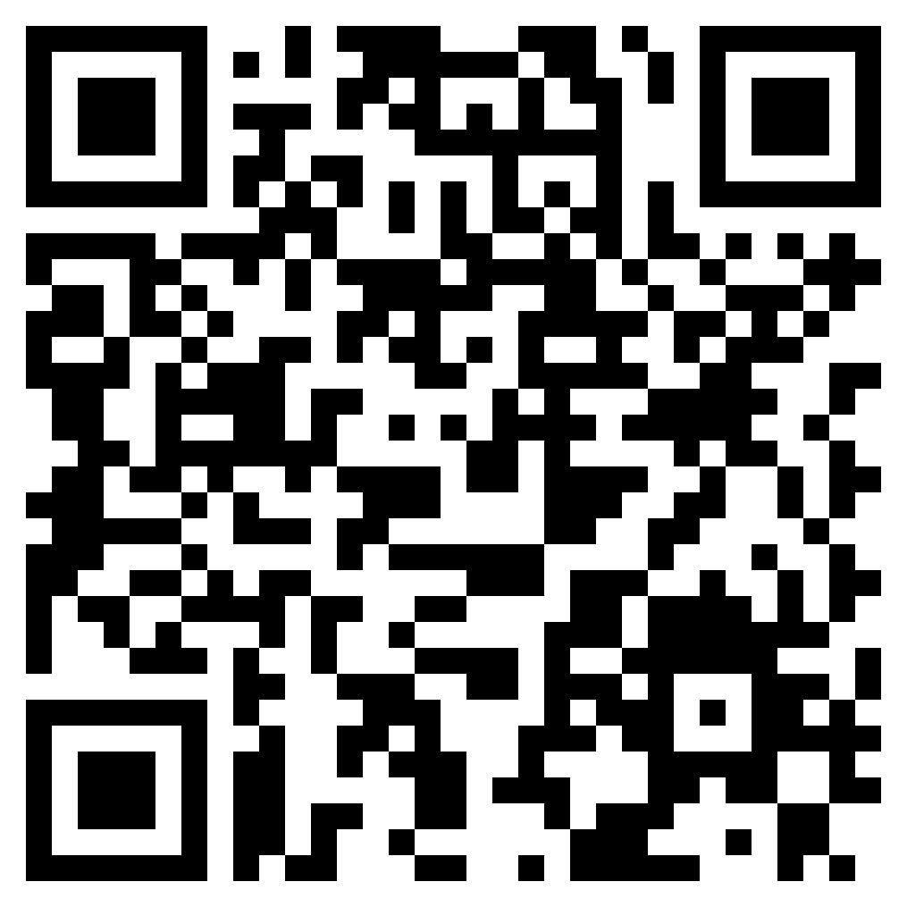
### Links: Led Potentiometer SlideSwitch I2C LCD Buzzer NeoPixcel PIR Servo Relay DHT22 IoT(Read DHT22)-Thingspeak
PPT Link
IoT Workshop

